Slide 1
iQuCodeFest 2026
Quantum Concordia
“Nature isn’t classical, dammit, and if you want to make a simulation of nature, you’d better make it quantum mechanical.” — Richard Feynman
TEAM: Kwali Duval , Cyril Costes, Theo-Dayan Rodriguez, Ivan Kamisarau, Jeffrey Bringolf

Slide 2
Quantum Image Analysis

Slide 3

Motivation & Problem Statement
Large Image datasets often contain redundant or repeated regions
Images are split into m patchs:
D(i) = patch_i
Goal: find any pair (i,j) i≠j , such that:
D(i)=D(j)
This is an all-pairs duplicate search problem
Classical brute-force approach requires:
n : number of pixels
O(n^2)
Even optimized hashing struggles with:
Near-duplicates
noisy transformations (rotation, scaling, compression)

Slide 4
Image Representation
Small binary patches → encoded as bitstrings
Image is divided into fixed-size patches (size n/m)
Each patch is flattened into a bitstring
Goal is to compare raw pixels
Each patch represents a local visual region of the image, encoded as a binary feature vector

Slide 5
Quantum Reformulation of the Problem
Convert duplicate detection into a search problem over pairs
Instead of comparing sequentially, consider all pairs simultaneously
Brute Force
O(n^2)
Hashing:
O(n)
Limitations:
Sensitive to noise / transformations
Near-duplicates are hard
Brute force scales poorly for large datasets

Slide 6




Quantum Encoding + Oracle
Represent image patch indices using two quantum registers:
∣ i ⟩∣ j ⟩
Create superposition of all possible pairs:
Each state represents a possible comparison between two image patches
Oracle checks for matching patches:
Equality test performed using bitwise XOR:
f(i, j) =
Oracle marks valid pairs by phase flip:

Slide 7

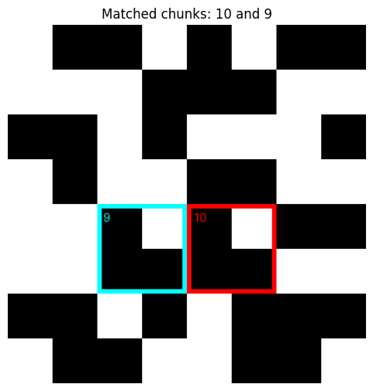
Grover Amplification
Oracle marks correct pairs (phase flip)
Grover diffusion increases matching pairs probability
Reduces amplitude of non-matching pairs

Slide 8
Result & Conclusion
Grover’s algorithm amplifies the probability of correct matching pairs
Classical brute force Time Complexity:
O(n^2)
Quantum Grover search Time Complexity:
O(n)

Slide 9
Limitations & Improvements
Requires quantum memory (QRAM assumption)
Classical hashing may outperform for exact duplicates
Sensitive to noise (exact match required)
Perceptional hashing for close matches
Non-orthogonal image state preparation using feature encoding

Slide 10
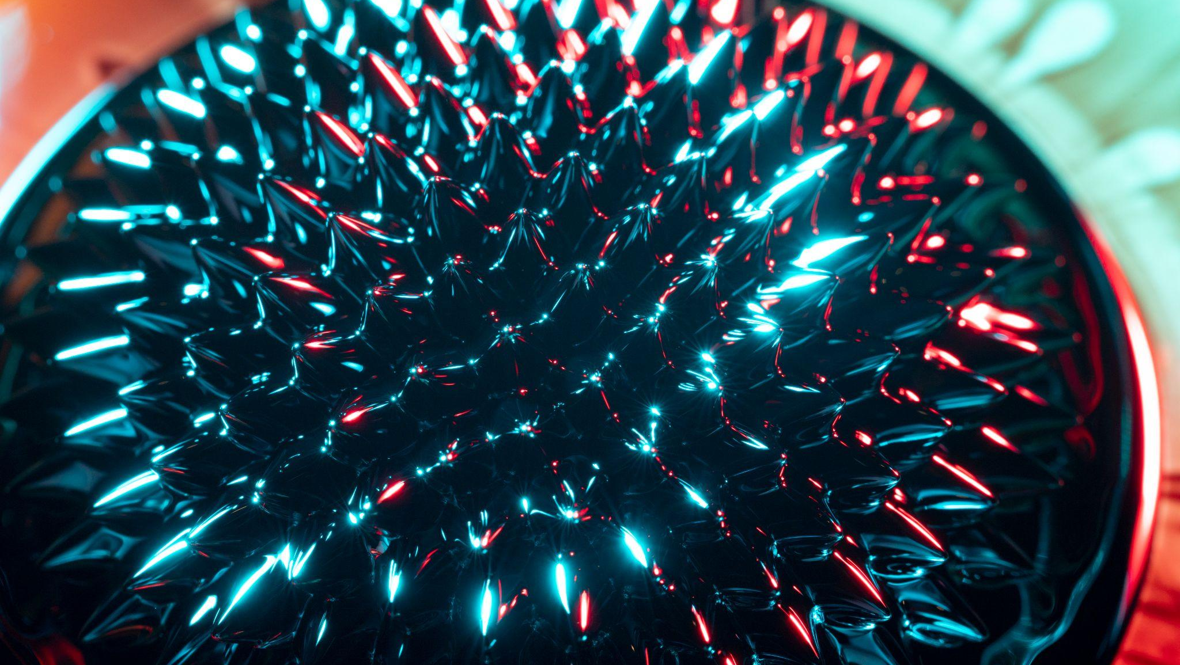
END

